Slide 1
Pedestrian Detection and Localization
Members:
Đặng Trương Khánh Linh 0612743
Bùi Huỳnh Lam Bửu 0612733
Advisor:
A.Professor Lê Hoài Bắc
UNIVERSITY OF SCIENCE
ADVANCED PROGRAM IN COMPUTER SCIENCE
Year 2011

Slide 2
Outline
Introduction
Problem statement & application
Challenges
Existing approaches.
Review HOG and SVM
Motivation
Overview of methodology
Learning phase
Detection phase
Our contributions:
Spatial selective approach
Multi-level based approach
Fusion Algorithm - Mean Shift
Conclusions
Future work
Reference

Slide 3
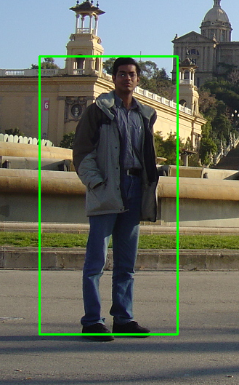
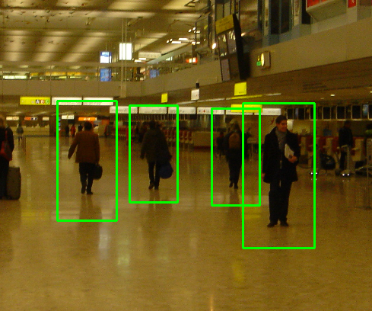
Problem statement
Build up a system which automatically detects and localizes pedestrians in static image.
Pedestrians: up-right and fully visible.
Notes:
Our thesis goal is building up an automatic system which can detects & localizes pedestrian objects in static images. More specific our detector will scan all the given images and bound the box around object if it appears in image. Pedestrian should stand up and fully visible in the picture. Our thesis is based on Dalal work – Normalized Histogram of Oriented Gradients (HOG).
We concentrate on extracting robust feature.

Slide 4
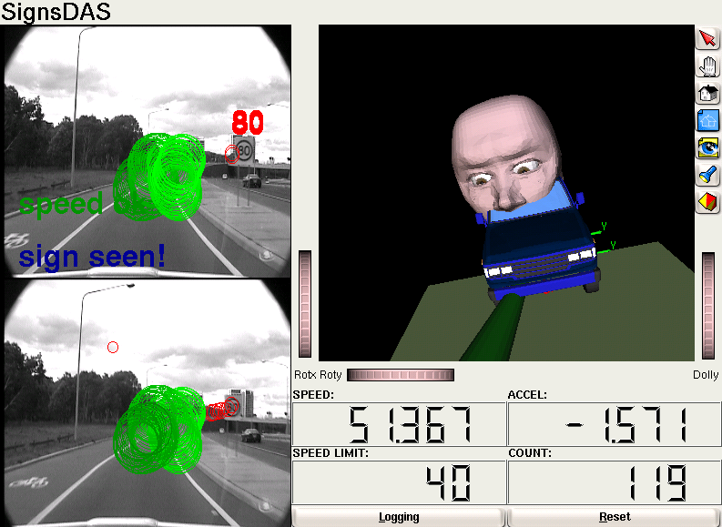
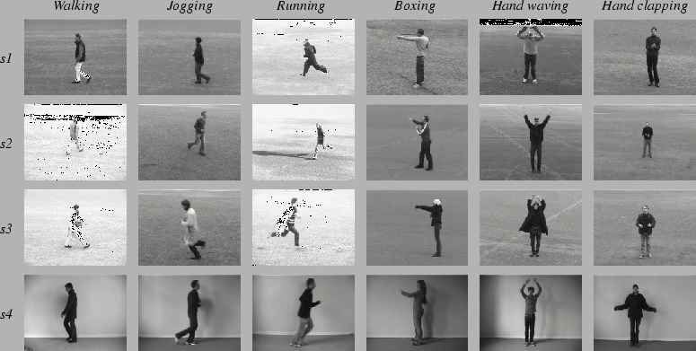
Applications
Automated Automobile Driver , or smart camera in general.
Build a software to categorize personal album images to proper catalogue.
Video tracking smart surveillance.
Action recognition.
Notes:
Develop a System for Smart car which automatically detect objects & a warning msg will appear whether the car tends to hits people or obstacle on the street.
Every person has thousands of photo. Another application is a software that can automatically category personal album.
Object Detection is one of the first phase of many of computer vision problems like video tracking, or action recognition.

Slide 5
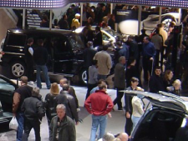
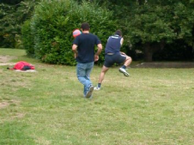
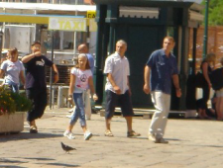
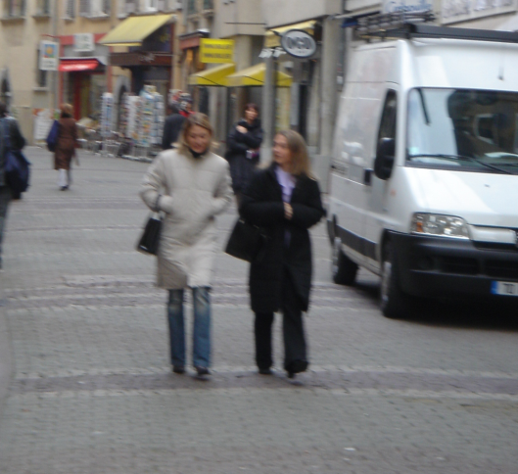
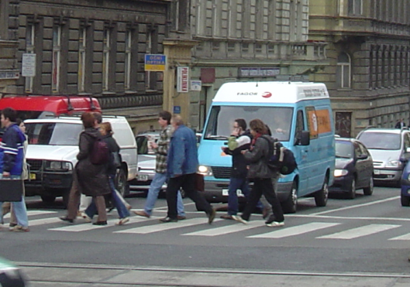
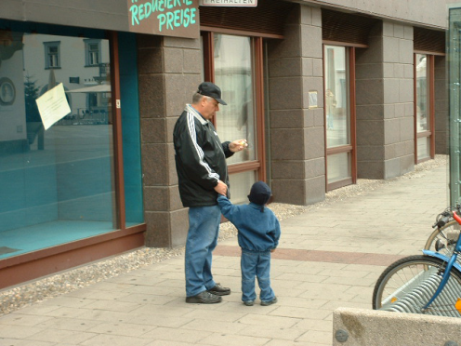
Challenges
Huge variation in intra-class. Non-constraints illumination.
Variable appearance and clothing. Complex background.
Occlusions, different scales.
Notes:
There’re challenges that make pedestrian detection has more difficult
Huge variation in intra-class
Variable appearance and clothing
Background clutter varies from image to image. For example, images can be taken from indoor, outdoor, and under diverse natural factors such as illumination, viewpoint.
Color

Slide 6

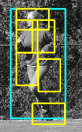

Existing approaches
Haar wavelets + SVM: Papageorgiou & Poggio, 2000; Mohan et al 2000
Rectangular differential features + adaBoost: Viola & Jones, 2001
Model based methods: Felzenszwalb 2008
Local Binary Pattern: Wang 2009
Histogram of Oriented Gradients: Dalal and Trigg 2005
Felzenszwalb
CVPR 2008
Wang
ICCV 2009
Notes:
Object detection in general, or pedestrian detection in specific has attracted a lot researcher’s attention. These are some well-known approach up to decade years ago. There are Haar wavelet and Rectangle differential feature which utilize the different between two rectangle. Recently, Felzenszwalb proposed model based method which use HOG as extraction algorithm. The traditional method, SIFT, is also another well-known work. LBP use the order of pixel to construct histogram. Last but not least, HOG utilize gradients information of pixel.

Slide 7
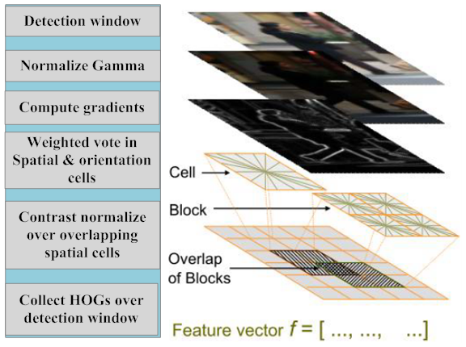
Histogram of Oriented Gradients (HOG)
Base on the gradient of pixels.
Notes:
Because our thesis is based on Histogram of Oriented Gradients, in short HOG. So, we will briefly review HOG method. In pre-processing, detection window is normalized to reduce the illumination effect. Gradient of pixels will be computed and vote to spatial and orientation cells. Block which consists of 4 cells will be contrast normalized and concatenated to form final window feature vector.

Slide 8
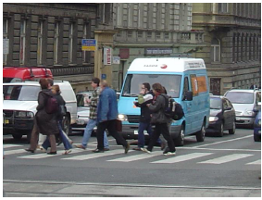
Histogram of Oriented Gradients Review
block
cell
9 orientation bins
0 - 180° degrees
Feature vector
f = […,…,…, ,…]
normalize
9x4 feature vector per cell
Notes:
For example, sliding window will be divided into grid of points. Block includes 4 cell, each cell has a histogram constructed by pixel in this cell.

Slide 9
Histogram of Oriented Gradients Review
block
cell
9 orientation bins
0 - 180° degrees
Feature vector
f = […,…,…, ,…]
normalize
9x4 feature vector per cell

Slide 10
Histogram of Oriented Gradients Review
block
cell
9 orientation bins
0 - 180° degrees
Feature vector
f = […,…,…, ,…]
normalize
9x4 feature vector per cell

Slide 11
Histogram of Oriented Gradients Review
block
cell
9 orientation bins
0 - 180° degrees
Feature vector
f = […,…,…, ,…]
normalize
9x4 feature vector per cell

Slide 12
SVM Review

Slide 13
Motivation of choosing HOG
The blob structure based methods have fail to object detection problem.
Object detection methods via edge detection are unreliable.
Use the advantage of rigid shape of object.
Has a good performance and low complexity.
Disadvantages:
Very high dimensional feature vector.
Lack of multi-scale shape of object.
Notes:
It’s just suitable for matching problem.
Affect a lot by the variation of intra-class and noise of background.
Though people has diversity of shape, in specific circumstance such as walking in the street, people usually are up-right.

Slide 14
Contributions
Re-implement HOG-based pedestrian detector.
Spatial Selective Method.
Multi-level Method.
Notes:
From the disadvantages of HOG we observe, we proposed two methods in order to overcome them. First, SSM is a method of eliminate unimportant region of image to shrink feature vector. Second, MLM get more information about object’s shape to make the feature set more robust. We also re-implement HOG of Dalal. This is not somehow re-invent the wheel, we have to do this to fully understand the philosophy under HOG method.

Slide 15
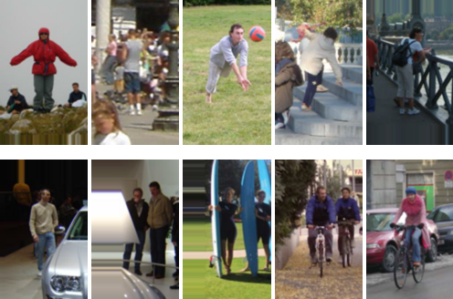
Dataset
INRIA pedestrian dataset
Train: 1208 positive windows 1218 negative images
Test: 566 positive windows 453 negative images
Notes:
We use INRIA pedestrian dataset which is very challenge b.c people in diverse shape and complex background.

Slide 16
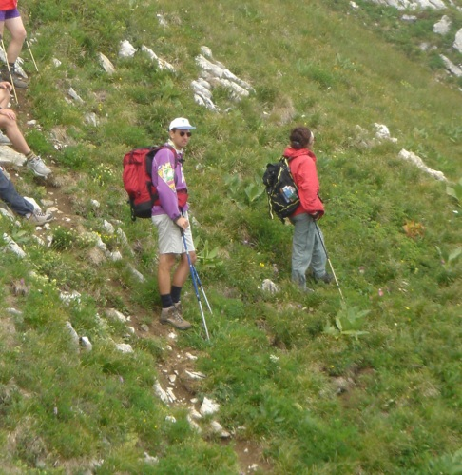
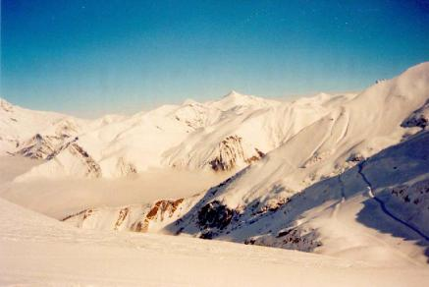


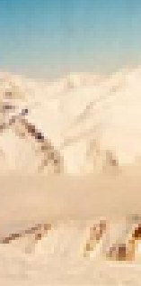
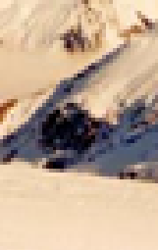
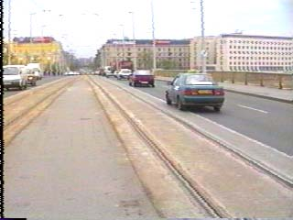
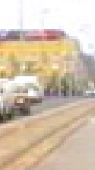
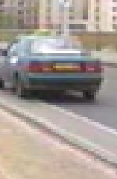
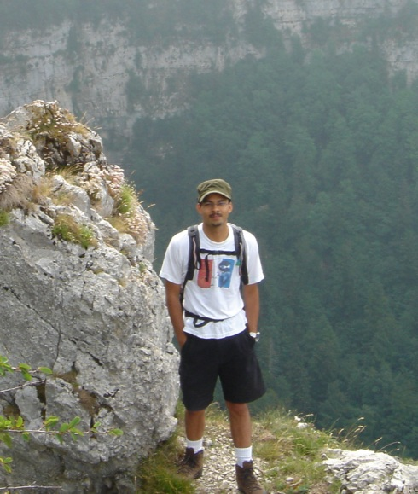

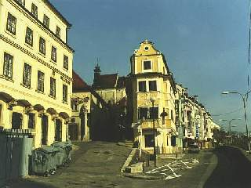
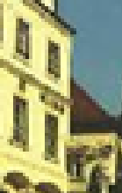
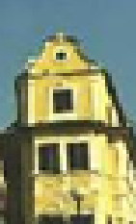
Dataset
Positive images | Negative images | Positive windows | Negative windows
Notes:
These are some examples of images and windows.
As you can see, a window is a part of a image.
In positive windows, pedestrian stands in the center of image.

Slide 17
Overview of methodology
Learning Phase:
Input: positive windows and negative images.
Output: binary classifier
Detection Phase:
Input: arbitrary image.
Output: bounding boxes containing pedestrians.

Slide 18
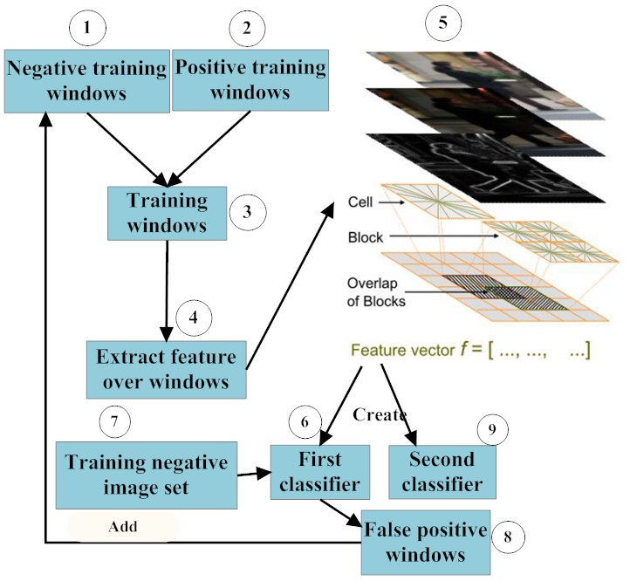
Learning Phase
Notes:
In learning phase, firstly, we have a training dataset which content negative& pos windows.
We extract the features over windows in this training set in order to create the first classifier.
But we cannot use this classifier, b/c it’s very sensitive with false positive windows.
We use the first classifier to run on training negative set to get all false pos windows.
After that, we add these false pos windows into training set, training again, to get the better- second classifier

Slide 19
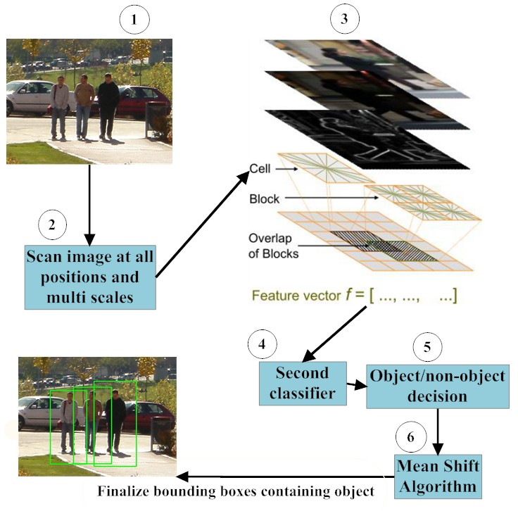
Detection Phase

Slide 20
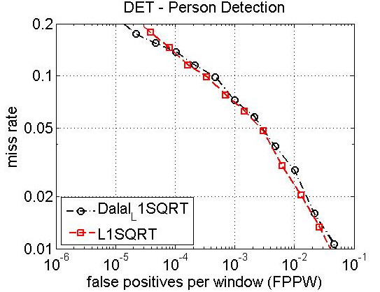
Result of re-implementation

Slide 21
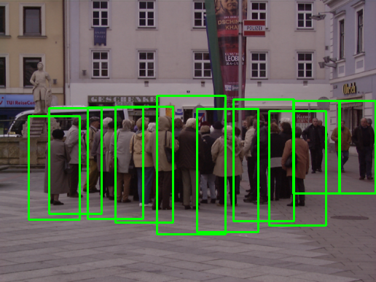
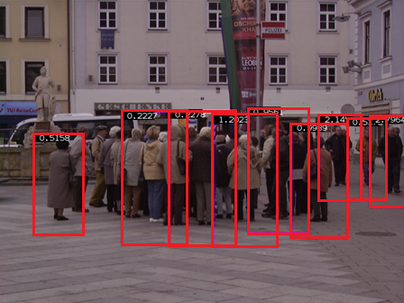
Examples

Slide 22
Contributions
IMPROVEMENTS
PERFORMANCE
(Spatial Selective Approach)
ACCURACY
(Multi-Level Approach)

Slide 23
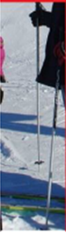
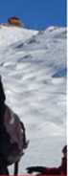
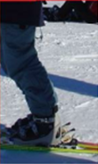
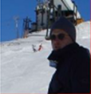
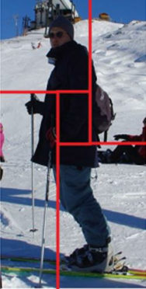
Spatial Selective Approach
Less informative region
Descriptor
[A1,..,Z1]
[A2,..,Z2]
[A3,..,Z3]
[A4,..,Z4]
[A1,..,Z1, A2,..,Z2, A3,..,Z3, A4,..,Z4]
Notes:
By experiment, we observe that there is a small region in the center of window which mostly contains chest and stomach is less informative.
We remove the small region at the center, and divide the image into 4 parts.
With each part, we compute the feature vector.
Finally, we concatenate 4 vectors into the feature vector of the whole img

Slide 24
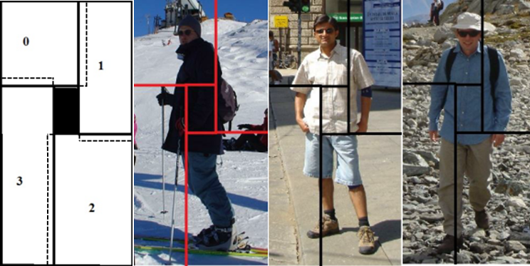
Spatial Selective Approach
Examples:
Notes:
The center region mostly contains chest and stomach is less informative.
Region (0) & 2 contain most information. Region (0) contains the head and left shoulder.
Region (2) has information of legs.
Region (1) occupies right shoulder, The (3) one is unreliable because sometimes it does not have any object information.
When we test these four parts independently, their performance of them is extremely low because they lack of whole object information.
One more thing that significantly affects performance is the overlap of regions. The more these regions overlap to each other, the more accuracy it is. Nonetheless, percentages of overlap of regions accompanies with the size of feature vector.

Slide 25
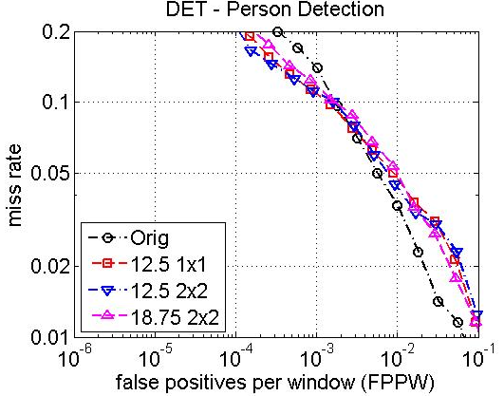
Result Spatial Selective Method
Notes:
The performance of this new one is approximate with the original one thought the length of new feature vector is reduced by 15-25%.

Slide 26
Vector Length v.s Speed
A:B → Deleted cell(s): Overlap cell(s)

Slide 27

Examples
Original
Re-implement

Slide 28
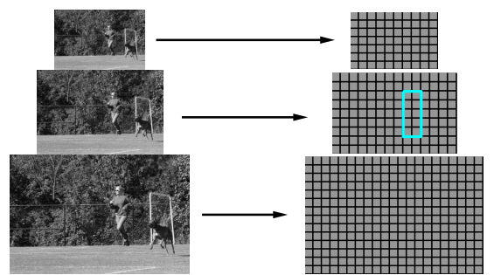
Multi-level Approach
Purpose: enhance the performance by getting more information about shape of object.
Inspired by pyramid model
Notes:
Our goal in this method is to enhance the accuracy of the detector by adding more object’s shape information. We’re inspired by the pyramid model which is likely see object from near and far distance.

Slide 29

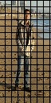
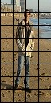
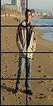
Multi-level Approach
HOG
[A1,..,Z1]
[A2,..,Z2]
[A3,..,Z3]
[A1,..,Z1, A2,..,Z2, A3,..,Z3, A4,..,Z4]
Notes:
Instead of zoom in or zoom out window like the pyramid model, we use different grid of points apply on each level. The grids are designed from fine to coarse. In the dense grid, it is likely we look object in the near distance. So we see object in detail. And in the other level, it look like we see object in far distance, we get object’s shape more general.

Slide 30
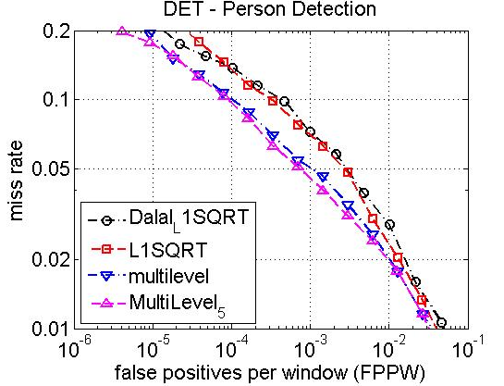
Result(cont…)

Slide 31
Feature vector length v.s Time

Slide 32
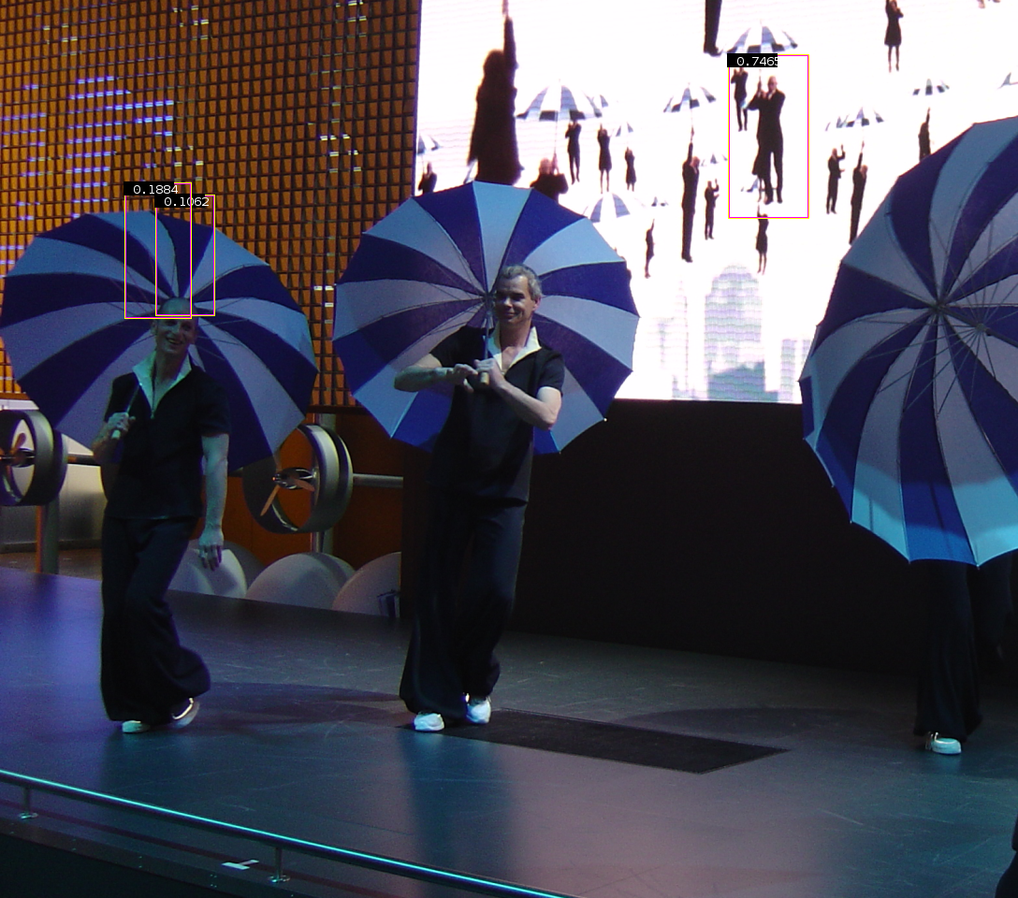
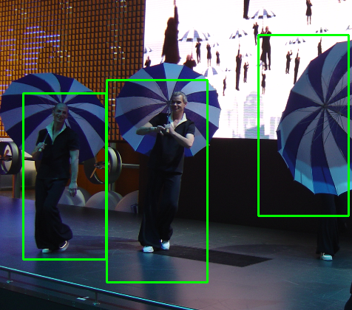
Examples
Original
Multi-level

Slide 33
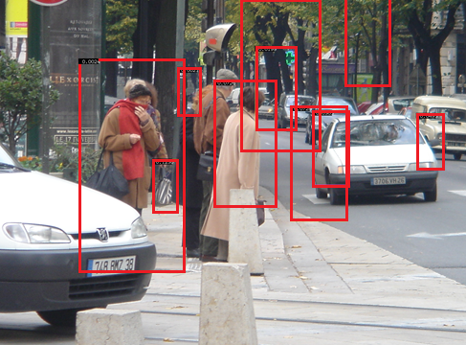
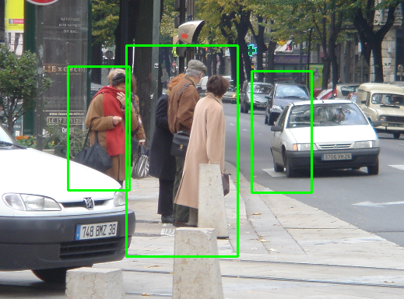
Examples (cont)

Slide 34
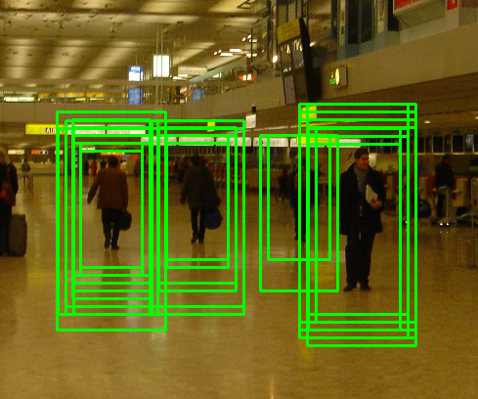
Fusion Algorithm – Mean Shift

Slide 35
Mean shift
Region of
interest
Center of
mass
Mean Shift
vector
Slide by Y. Ukrainitz & B. Sarel

Slide 36
Mean shift
Region of
interest
Center of
mass
Mean Shift
vector
Slide by Y. Ukrainitz & B. Sarel

Slide 37
Mean shift
Region of
interest
Center of
mass
Mean Shift
vector
Slide by Y. Ukrainitz & B. Sarel

Slide 38
Mean shift
Region of
interest
Center of
mass
Mean Shift
vector
Slide by Y. Ukrainitz & B. Sarel

Slide 39
Mean shift
Region of
interest
Center of
mass
Mean Shift
vector
Slide by Y. Ukrainitz & B. Sarel

Slide 40
Mean shift
Region of
interest
Center of
mass
Mean Shift
vector
Slide by Y. Ukrainitz & B. Sarel

Slide 41
Mean shift
Region of
interest
Center of
mass
Slide by Y. Ukrainitz & B. Sarel

Slide 42
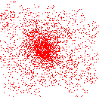
Mean shift clustering
Cluster: all data points in the attraction basin of a mode
Attraction basin: the region for which all trajectories lead to the same mode
Slide by Y. Ukrainitz & B. Sarel

Slide 43
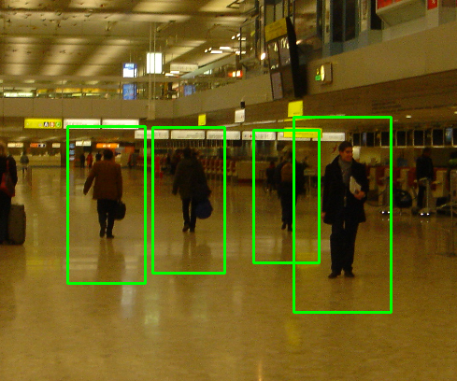
Non-maximum suppression
Using non-maximum suppression such as mean shift to find the modes.

Slide 44
Conclusions
Successfully re-implement HOG descriptor.
Propose the Spatial Selective Approach which take advantages of less informative center region of image window.
Multi-level has more information about shape of object.
It is general model, and can apply to any object.

Slide 45
Future work
Non-uniform grid of points.
Combination of Spatial Selective and Multi-level approach.
Notes:
Combine the advantages of spatial selective method & multi-level method in order to enhance the performance & accuracy of algorithm
Non-uniform grid of points, we focus on the important regions which contain more informations

Slide 46
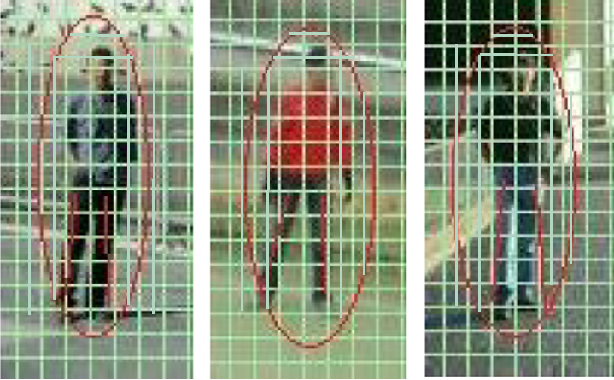
Non-uniform grid of points

Slide 47

Demonstration

Slide 48
References
N. Dalal and B. Triggs, “Histograms of oriented gradients for human detection,” in IEEE Conference on Computer Vision and Pattern Recognition, 2005.
Subhransu Maji et al. Classification using Intersection Kernel Support Vector Machines is Efficient. IEEE Computer Vision and Pattern Recognition 2008
C. Harris and M. Stephens. A combined corner and edge detector. In Alvey Vision Conference, pages 147–151, 1988.
D. G. Lowe. Distinctive image features from scale-invariant keypoints. International Journal of Computer Vision, 60(2):91–110, 2004.

Slide 49



Scan image at all positions and scales
Object/Non-object classifier

Slide 50

Miss rate = 1 – recall $=\frac{fn}{tp+fn}$
 | True | False
True | tp | fn
False | fp | tn

Slide 51

Overview of methodology

